Slide 1

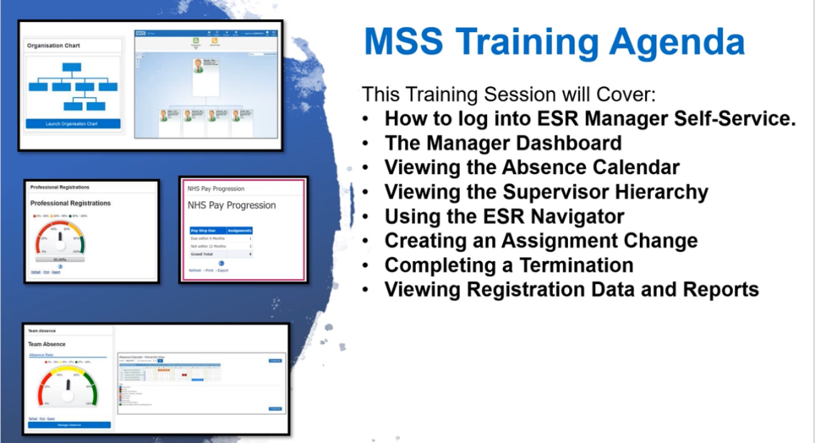
ESR Manager Self Service Demo for Managers
Getting you logged into ESR & Smart cards
Menus
Your team
Annual leave
Sickness
Where to access Training
Notes:
Introduce the scope. Suggested running time: 8–10 minutes. Use a training account or anonymised record, with permission. Keep passwords, one-time codes and colleagues’ personal information off the shared screen. Switch between these prompts and the live ESR system. The national guides describe functionality. Confirm local access and recording arrangements before presenting.
[Sources]
NHSBSA, ESR Manager Self Service - Functional Guide v2.0 (1), pages 3–7. Source key: file_34f18f4b.
Existing ICB logo and design retained from the working presentation.

Slide 2
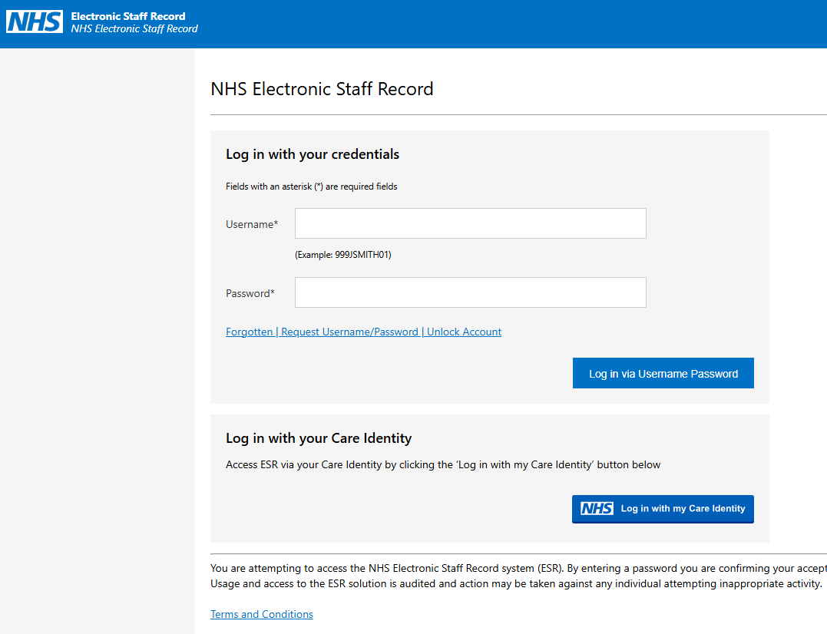
Logging in to MSS
Accessing the ESR System
Use this to log in with Smart card
Notes:
Demo: open ESR using the ICB-approved access route. Use the Smartcard associated with your ESR record, or configured internet access. From the portal select My Role, then Manager. For upgraded internet access, use Manage Internet Access and enter the one-time code sent to the registered mobile number. Keep PINs and codes off the shared screen. If Manager is missing, ask local ESR support to check your access.
If a Smartcard is locked: Smartcard ESR signposts the self-service unlock portal. Insert the card, start the process, choose email or mobile delivery for the security code, then follow the prompts to set and confirm a new PIN. Do this privately, outside the live demonstration.
Unlock portal: https://manage-care-identities.care-identity-service2.nhs.uk/#/self-service/unlock-authenticator
[Sources]
NHSBSA, ESR Manager Self Service - Functional Guide v2.0 (1), pages 3–7. Source key: file_34f18f4b.
Manager Self Service MSS Information guide, Manager Internet Access Functional Wrap, January 2021, pages 2–3. Source key: file_d9c170df.
Smartcard ESR. Source key: file_aa3ebae7, retrieved search excerpt. Its full file format was not accessible.
Existing ICB logo and design retained from the working presentation.

Slide 3
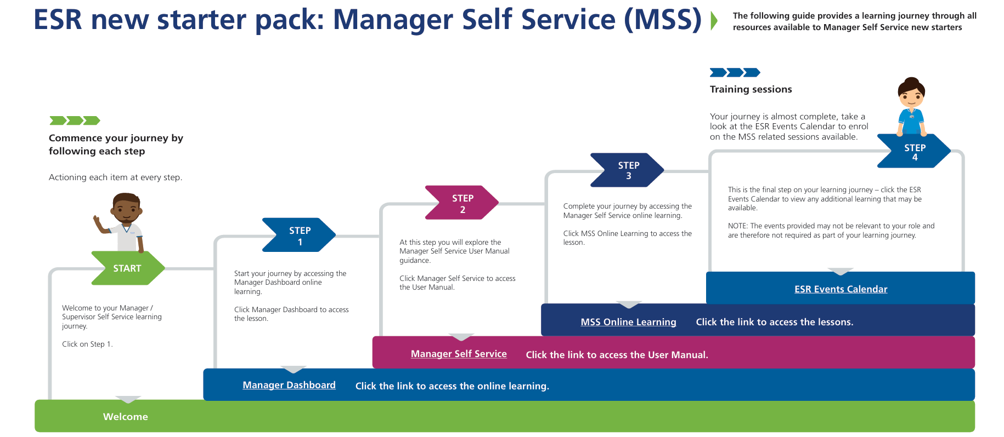
Getting Started
Navigation menu
Manager Dashboard
My Role
Organisation Chart
Switch to the Manager view.
See who reports into you.
Reporting
Team Absence
Open Business Intelligence for detailed reports.
Review annual leave and record sickness.
Manager Self Service - access guidance here - You can follow a training package here
Notes:
Point out the left navigation menu and dashboard portlets. Explain that a portlet is simply a dashboard tile. Show Organisation Chart and Team Absence first. Mention Team Appraisals and Team Compliance only if visible, then return to the demo scope. Reporting, then Business Intelligence opens the report suite. Dashboard tiles can vary with local configuration.
[Sources]
NHSBSA, ESR Manager Self Service - Functional Guide v2.0 (1), pages 3–7. Source key: file_34f18f4b.
Existing ICB logo and design retained from the working presentation.

Slide 4
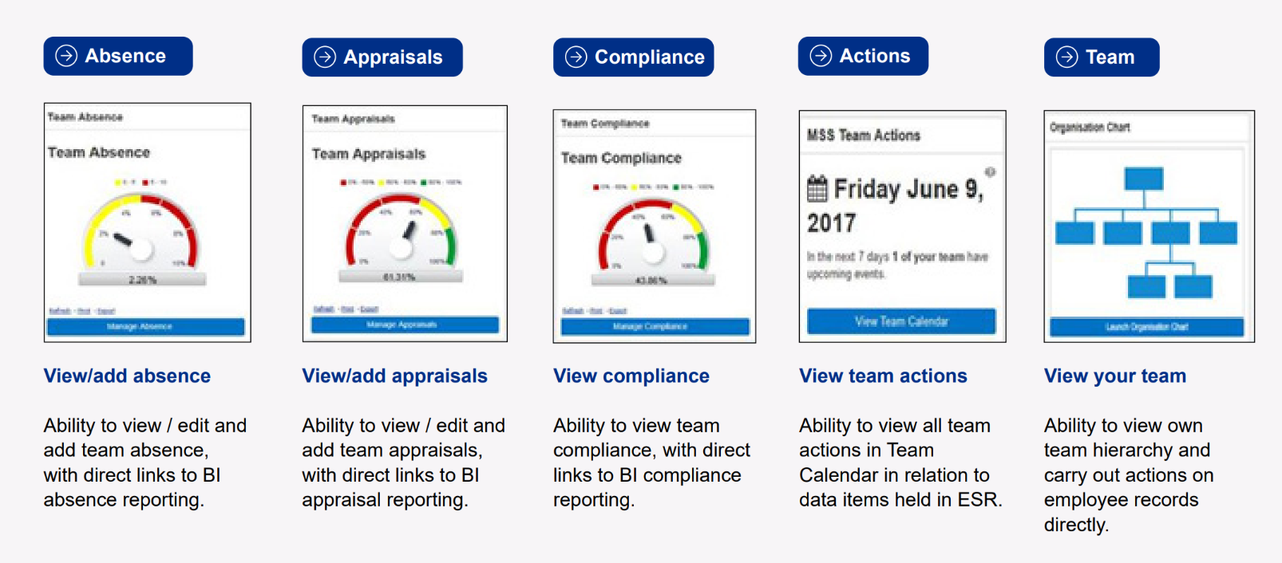
Dashboards
Note: Appraisals will be rolled
out from April 2027 for our ICB
Notes:
Point out the left navigation menu and dashboard portlets. Explain that a portlet is simply a dashboard tile. Show Organisation Chart and Team Absence first. Mention Team Appraisals and Team Compliance only if visible, then return to the demo scope. Reporting, then Business Intelligence opens the report suite. Dashboard tiles can vary with local configuration.
[Sources]
NHSBSA, ESR Manager Self Service - Functional Guide v2.0 (1), pages 3–7. Source key: file_34f18f4b.
Existing ICB logo and design retained from the working presentation.

Slide 5
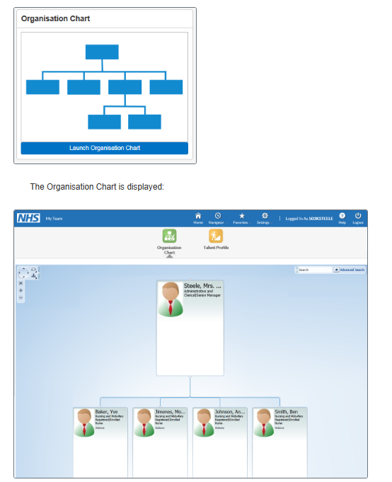
Your Team
Organisation Chart Direct reports- ESR User Manual
Check your line reports are correct
Notes:
Point out the left navigation menu and dashboard portlets. Explain that a portlet is simply a dashboard tile. Show Organisation Chart and Team Absence first. Mention Team Appraisals and Team Compliance only if visible, then return to the demo scope. Reporting, then Business Intelligence opens the report suite. Dashboard tiles can vary with local configuration.
[Sources]
NHSBSA, ESR Manager Self Service - Functional Guide v2.0 (1), pages 3–7. Source key: file_34f18f4b.
Existing ICB logo and design retained from the working presentation.

Slide 6
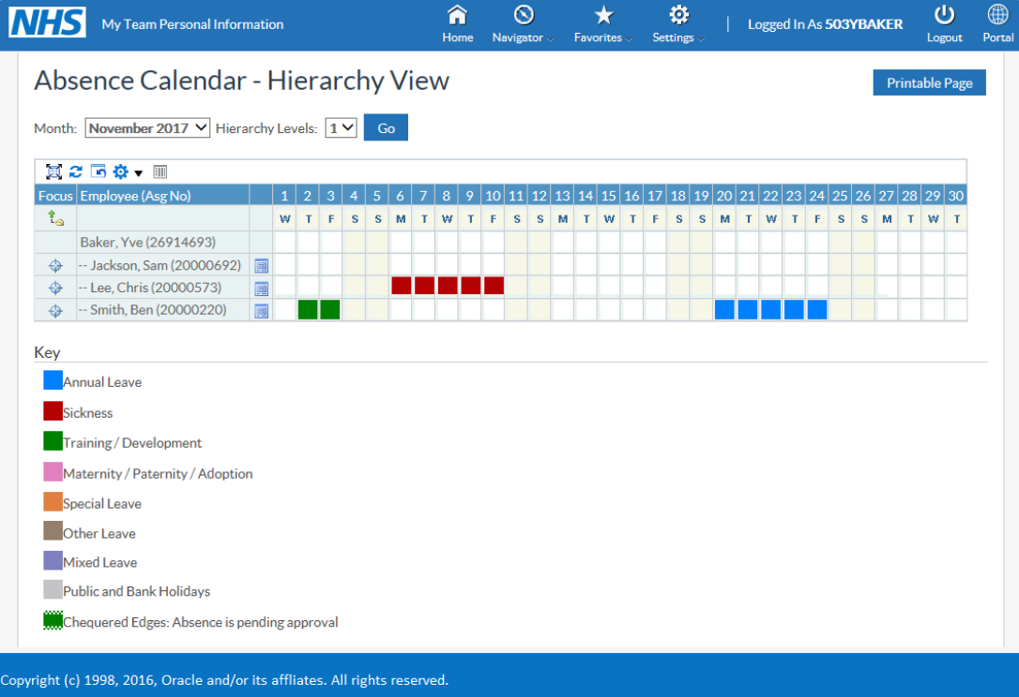
Annual Leave & Other leave
Absence Calendar Link to training
Notes:
Point out the left navigation menu and dashboard portlets. Explain that a portlet is simply a dashboard tile. Show Organisation Chart and Team Absence first. Mention Team Appraisals and Team Compliance only if visible, then return to the demo scope. Reporting, then Business Intelligence opens the report suite. Dashboard tiles can vary with local configuration.
[Sources]
NHSBSA, ESR Manager Self Service - Functional Guide v2.0 (1), pages 3–7. Source key: file_34f18f4b.
Existing ICB logo and design retained from the working presentation.

Slide 7
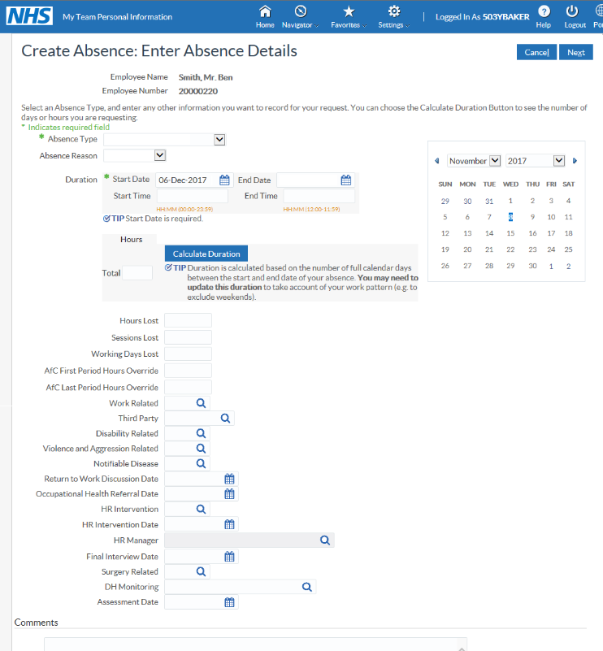
Sickness Recording
Recording Sickness Absence
Link to training
Notes:
Point out the left navigation menu and dashboard portlets. Explain that a portlet is simply a dashboard tile. Show Organisation Chart and Team Absence first. Mention Team Appraisals and Team Compliance only if visible, then return to the demo scope. Reporting, then Business Intelligence opens the report suite. Dashboard tiles can vary with local configuration.
[Sources]
NHSBSA, ESR Manager Self Service - Functional Guide v2.0 (1), pages 3–7. Source key: file_34f18f4b.
Existing ICB logo and design retained from the working presentation.

Slide 8
ESR Education within the system
?
Introduction to Manager Self Service training package
Recording Sickness Absence
Organisation Chart
Absence Calendar
Action a Change in Hours
Accessing ESR Over the Internet
Assign New Direct Reports
How do I view and action email notifications
Update Employee's Personal Information
Process Notifications
Follow these links to training and information within the ESR Hub
Notes:
Point out the left navigation menu and dashboard portlets. Explain that a portlet is simply a dashboard tile. Show Organisation Chart and Team Absence first. Mention Team Appraisals and Team Compliance only if visible, then return to the demo scope. Reporting, then Business Intelligence opens the report suite. Dashboard tiles can vary with local configuration.
[Sources]
NHSBSA, ESR Manager Self Service - Functional Guide v2.0 (1), pages 3–7. Source key: file_34f18f4b.
Existing ICB logo and design retained from the working presentation.

